Slide 1
Lecture 3 Use Case Diagram
Chapter 17 & 18
The Unified Modeling Language User Guide
SECOND EDITION
By Grady Booch, James Rumbaugh, Ivar Jacobson
Session 5 & 6
UML Weekend Crash Course
Thomas A. Pender

Slide 2
Objective
Capture the intended behavior of the system
Without specifying how that behavior is implemented.
Use cases provide a way for developers to come to a common understanding with your system's end users and domain experts.
In addition, use cases serve to help validate your architecture and to verify your system as it evolves during development.
Use cases specify WHAT are the externally visible behaviors; they DO NOT dictate HOW that behavior will be carried out internally.

Slide 3
What is Use Case?
A use case is a description of a set of sequences of actions, including variants, that a subject performs to yield an observable result of value to an actor.
For example, one central use case of a bank is to process loans for its loan applicants/ clients/ customers.

Slide 4
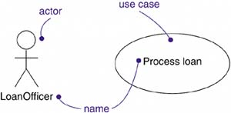
What is Actor?
An actor represents a coherent set of roles that users of use cases play when interacting with these use cases.
Actors can be human or they can be automated systems.
For example, in modeling a bank, processing a loan involves, among other things, the interaction between a customer and a loan officer.

Slide 5
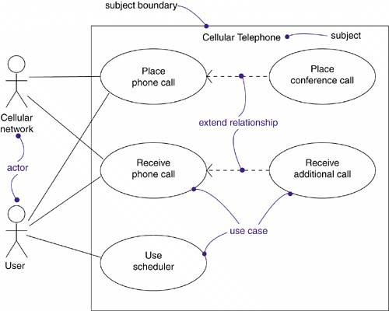
Use Case Diagram
Apply use case diagrams to visualize the behavior of a system, so that users can comprehend how to use that element, and so that developers can implement that element

Slide 6
Modeling the Requirements of a System
Establish the context of the system by identifying the actors that surround it.
For each actor, consider the behavior that each expects or requires the system to provide.
Name these common behaviors as use cases.
Factor common behavior into new use cases that are used by others; factor variant behavior into new use cases that extend more main line flows.
Model these use cases, actors, and their relationships in a use case diagram.
Enhance these use cases with notes or constraints that assert nonfunctional requirements; you may have to attach some of these to the whole system.

Slide 7
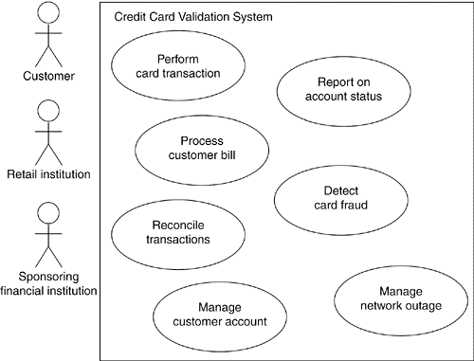
Modeling the Requirements of a System

Slide 8
Elements of Use Case Diagram

Slide 9
Relationships in Use Case Diagram
Association
Between Actor and its Use Cases
NOT between Use Cases
NOT between Actors
Generalization
Between Actors
Between Use Cases
Dependency
Between Use Cases ONLY
<<include>> and <<extend>>

Slide 10
Actors
Find the people, systems, or devices that communicate with the system.
The system-type actors are often easiest to spot as interfaces and external communication, such as notifications to the Accounts Payable and Order Processing systems.
The other actors will be participants in the operation of the Inventory Control system.
All these users will become sources for finding and validating the required features of the system (that is, Use Cases).

Slide 11
Notation of Actors

Slide 12
Dependency
<<include>>
Mandatory dependency
<< i >>
Arrow towards the use case dependent on
<<extend>>
Optional Dependency
<< e >>
Arrow from the use case dependent on
Often referred as options of the use case

Slide 13
<<include>> & <<extend>>

Slide 14
Generalization

Slide 15
Use Case Diagrams - practice
Case 1:
In a hotel management system a guest can rent rooms. Hotel receptionist uses the system to assist in the renting. A guest can also book a room for future renting with the help of the receptionist, but the receptionist has to check if the room has prior booking or not. A Guest can pay for his bill. He can pay by cash or credit card. Receptionists has to logon to the system before they can use it, but to logon he has go the system must verify his username and password.
Hotel Management System
Rent Room
Book Room
<<include>>
Check Availability
Guest
Receptionist
<< e >>
Pay Bill
<<extend>>
Pay by cash
Pay by card
verify
login
<< i >>

Slide 16
Use Case Diagrams - practice
Music Today
Case 2:
Music Today is an audio recording company. There are several recordists in the company. Clients record their music with the help of the recordists. The recording is done in a session. A session is usually created by the office clerk. A session needs to be booked by the client beforehand and before booking the time needs to be verified by the office clerk for availability. The company maintains a list of preferred clients who book sessions like regular clients but also can create sessions according to their needs. Clerks have to log in to use the system. Clients can pay in cash or card. The accounts department deals with the payment. The payment is only cleared when the accounts department receives clearance from the office clerk.
Record Music
Preferred
Client
Create Session
Recordist
Book Session
Check Availability
<< i >>
Office Clerk
Client
Pay Bill
<<extend>>
<< e >>
Pay by cash
Pay by card
<< i >>
Clearance
<< actor >>
Accounts
login

Slide 17
Use Case Diagrams - practice
Case 3:
ABCD Records is a mail order company that distributes CDs and tapes at discount prices to record club members. A member fills up an order form and sends it to the order processing clerk. When the order processing clerk receives an order form, she verifies that the sender is a club member by checking the member file. She also checks the status of the member whether he is a royal class member or regular class member. If the sender is not a member, the clerk returns the order along with a membership application form. If the customer is a member, the clerk verifies the order item data by checking the item file. Then the clerk enters the order data and saves it to the daily records file. At the same time the clerk also prints an invoice and shipping list for each order, which are forwarded to the collection department clerk for processing there. If the items are not available and if the member is a royal class member, items are ordered by the Oder Processing Clerk. Royal class members also get discounts. The members can pay by cash, check or bank draft.

Slide 18
Use Case Diagrams - practice
Case 4:
In a hospital management system a patient's medical history is created by a doctor. A patient may be referred by a doctor to be admitted in the hospital. A patient can rent hospital facilities. An administrative officer deals with the renting. The system automatically checks whether the patient is referred by a doctor before he can rent any hospital facility. The types of facilities are rooms, beds or ICUs. Admitted patients are regularly visited by doctors and a nurse updates patient medical history after each visit. A doctor writes the discharge note of the patient when he leaves. An account clerk prepares the bill. The bill is calculated from the elements written in the medical history, i.e. number of doctor's visit, prescribed medication, tests. When the nurse updates the medical history she writes either the date-time of doctor's visit or prescribed medication or test. The patient may pay by cash or card when the bill is prepared.

